Slide 1
Angular Testing
7 - E2E Basics
Notes:
Schwerer wirds nicht, dafür kann RxJS auch einiges
Komplexe RxJS kann aber nur mit Unit Tests testen
Man muss direkt an die Observables rankommen. Private Methoden oder so gehen nicht

Slide 2
End-to-End (E2E) Tests
Component Tests
(Functional & Visual)
Unit Tests

Slide 3
2 Core Technologies for E2E Frameworks
WebDriver
Chrome DevTool Protocol (CDP)

Slide 4
WebDriver
W3C Standard
Cross-Browser Support
Known to be flaky
WebDriver BiDi as successor
Popular E2E Tools
Protractor
Selenium
NightWatch
WebDriverIO

Slide 5
CDP (Chrome DevTools Protocol)
Debugging Tool for Chromium-based Browsers
Puppeteer as primary library
Playwright incl. Safari
Much more stable
Constrained to CDP-Browsers
Notes:
Selenium v4 provides CDP as well webdriverIO

Slide 6








Cross Browser Support
Reliability
WebDriver
CDP
(Chrome DevTools Protocol)
Native

Slide 7
Cross Browser Support
Reliability
WebDriver
CDP
(Chrome DevTools Protocol)
Native

Slide 8
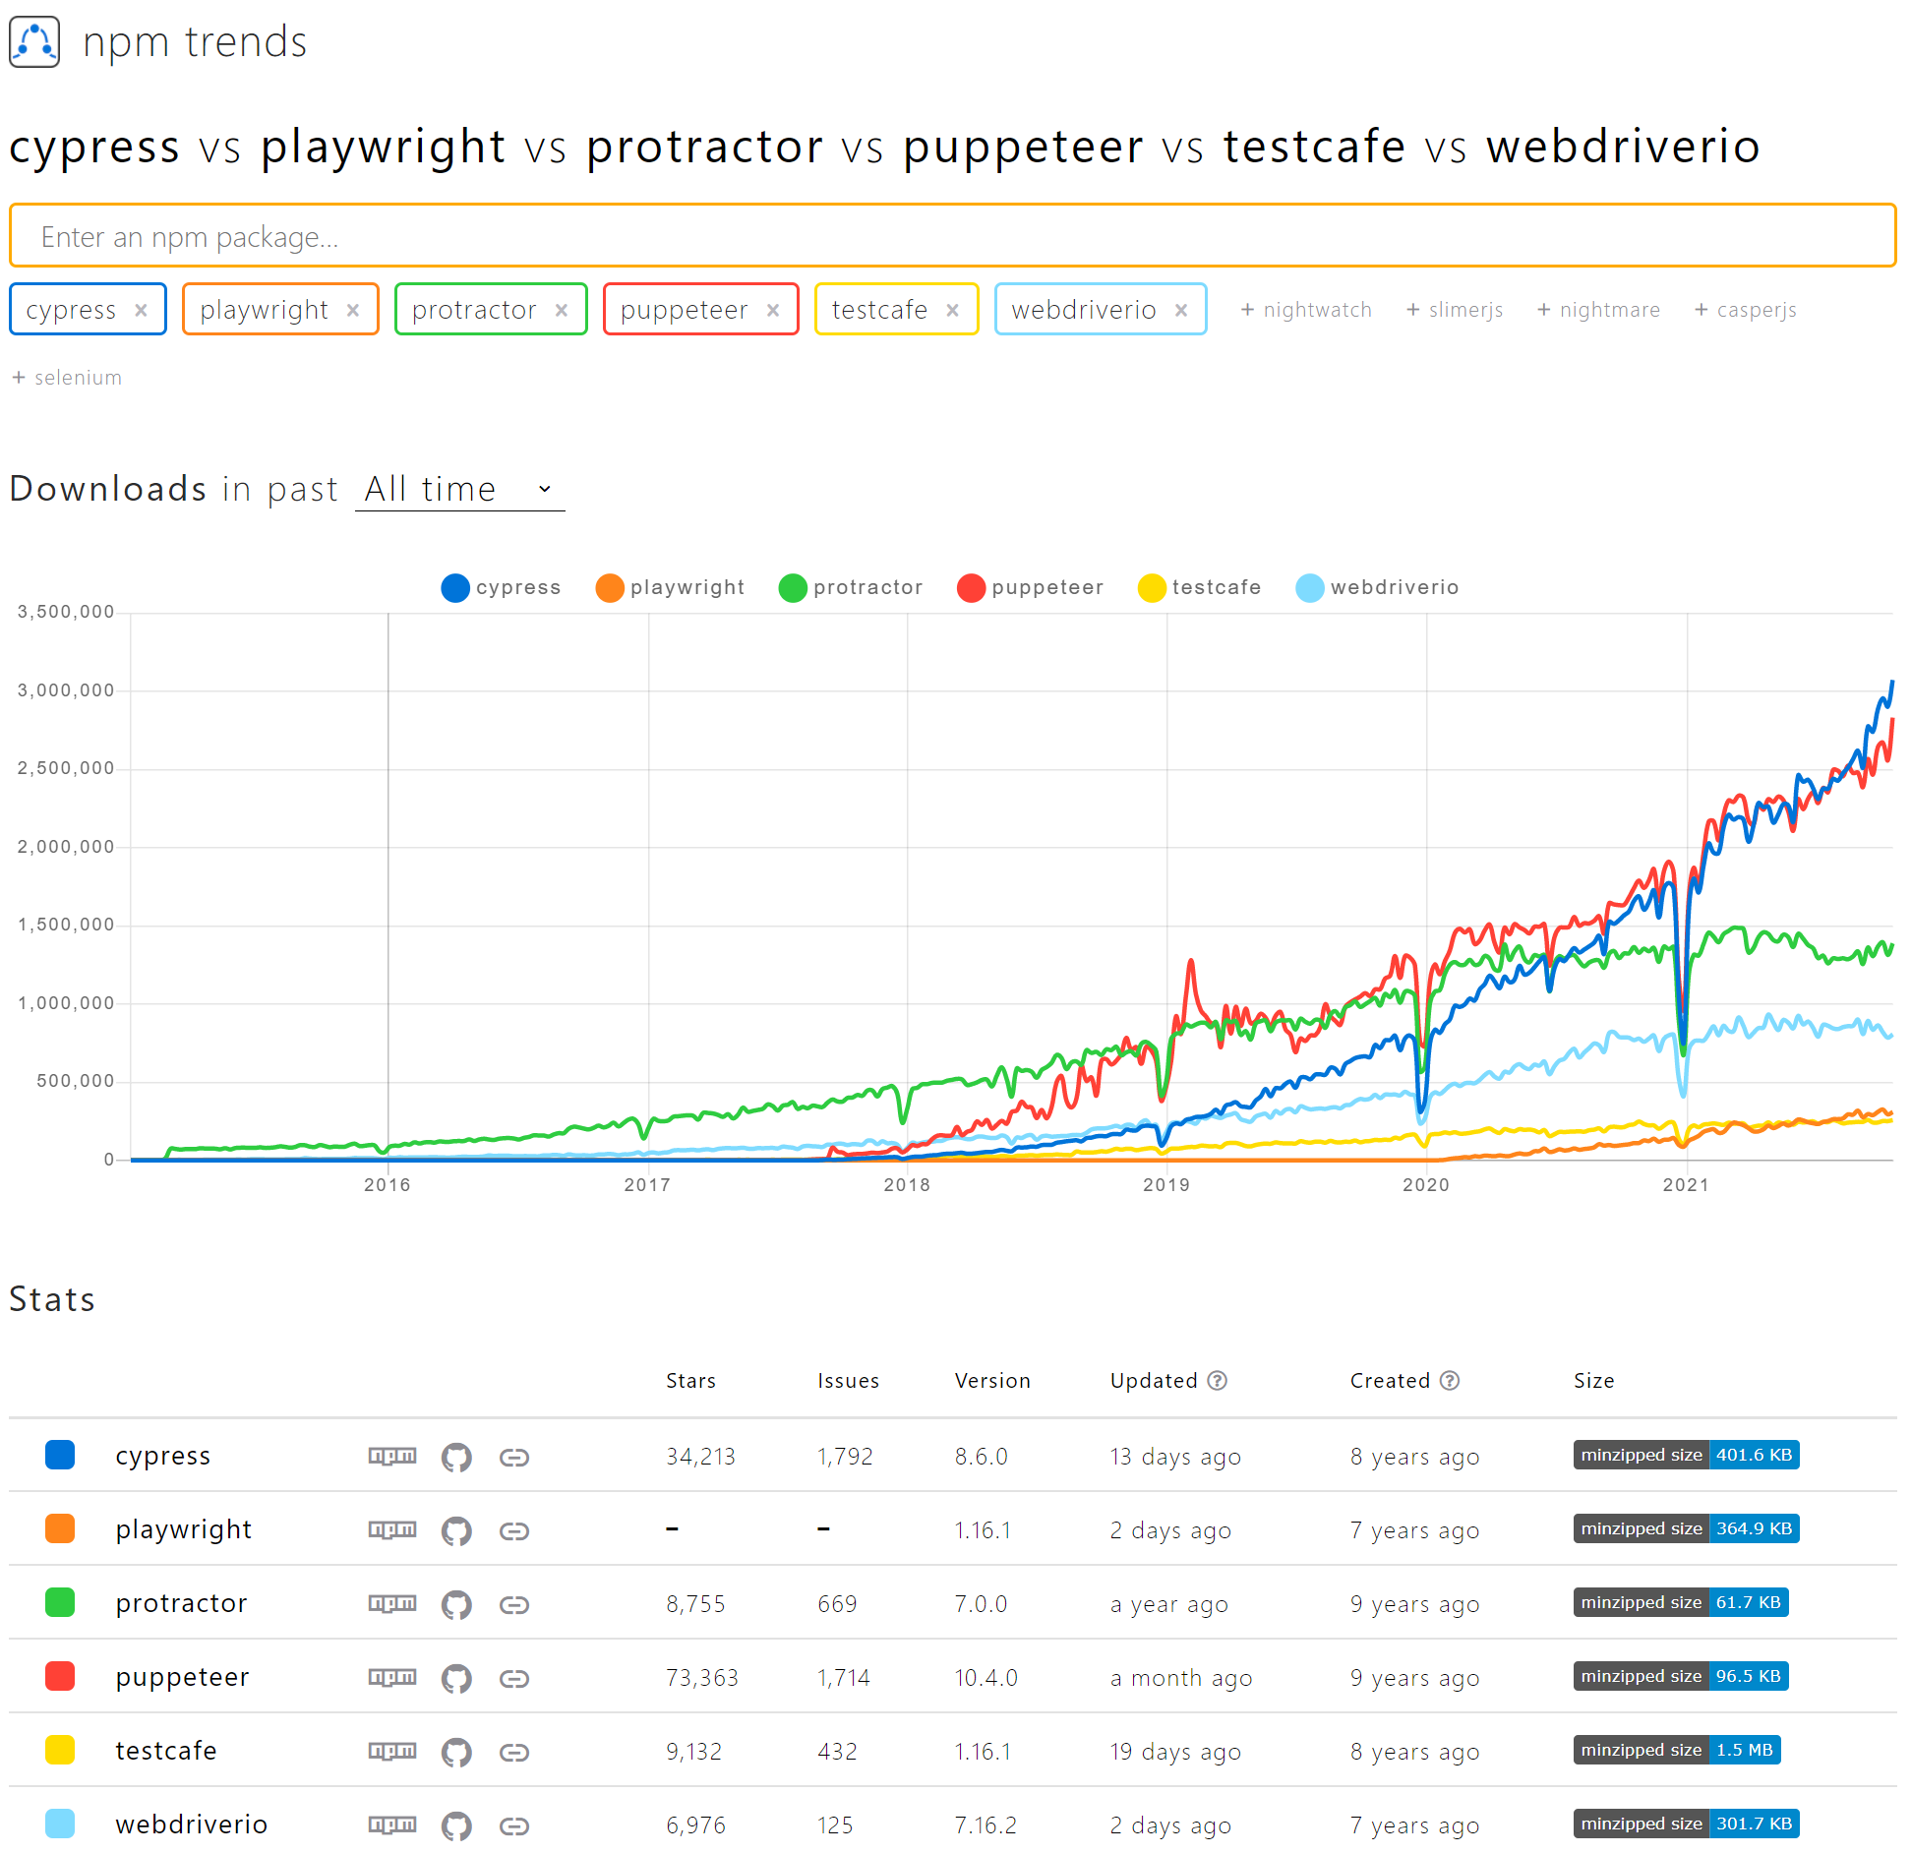

Slide 9
Cypress
Node.js Application
Great Developer Experience
Good Documentation
Easy Setup
Internal "IDE"
CI Features like Videorecording and Screenshots
Notes:
Problems with iFrames or multiple domains. Addressed in the roadmap
Dashboard for Flakey Tests and Parallel Runs

Slide 10
The Await Feature

Slide 11
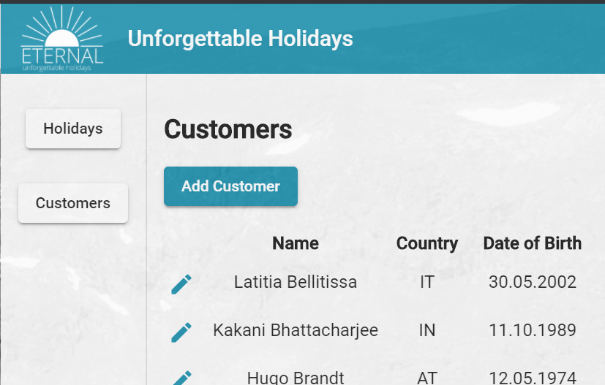
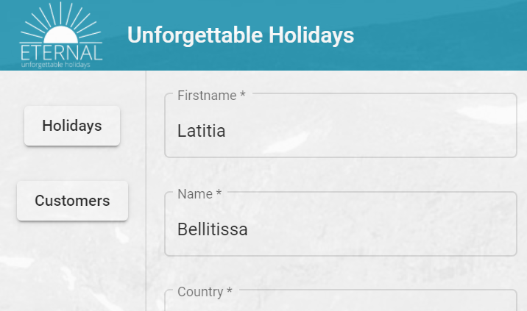
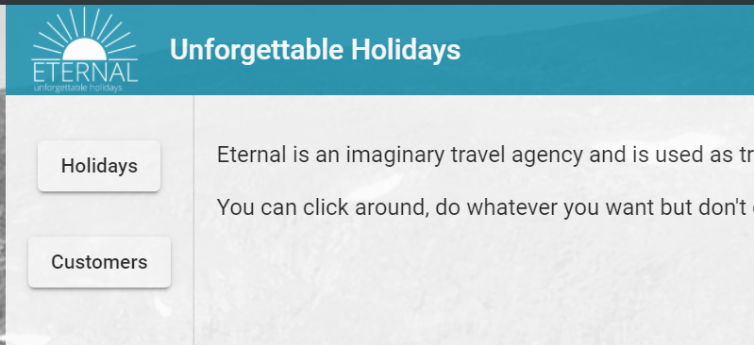
3
1
2
1. Select Customers
2. Select Customer
3. Edit Firstname

Slide 12
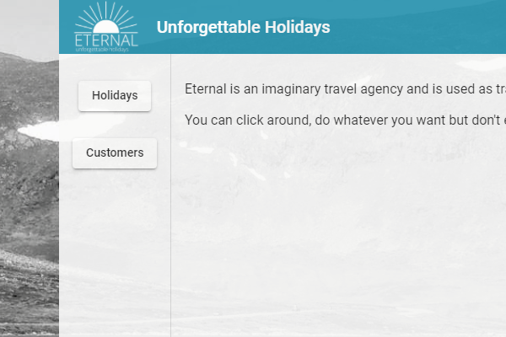
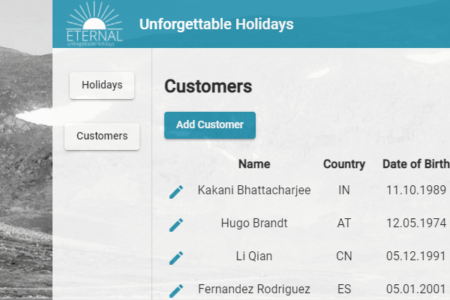
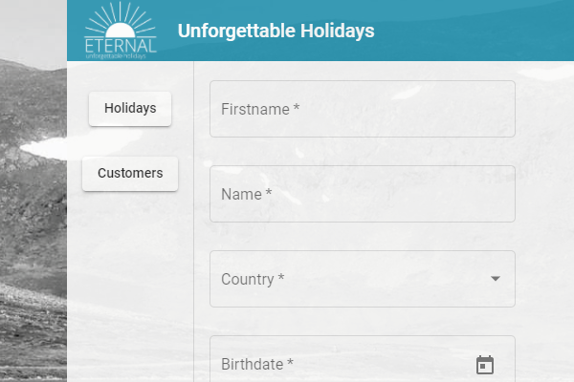



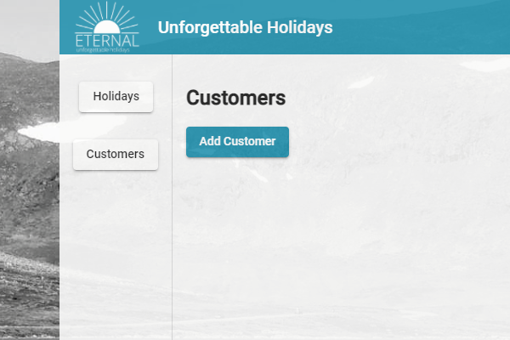
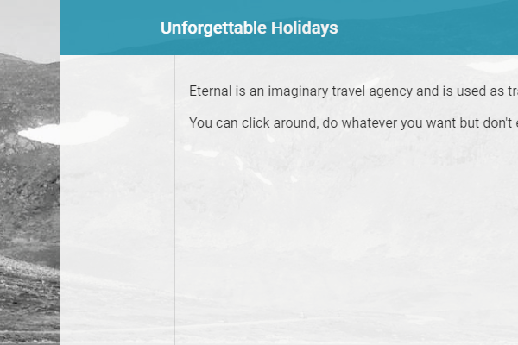


Slide 13
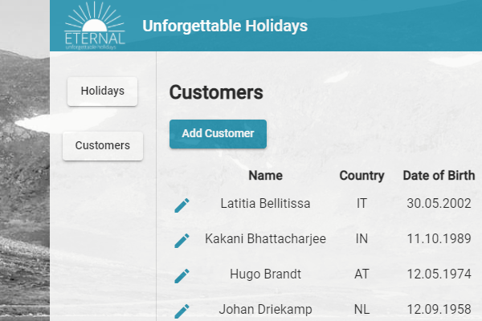
Non-Waiting Style
1. Select Customers
2. Select Customer
3. Edit Firstname

Slide 14
Non-Waiting Style
1. Select Customers
2. Select Customer
3. Edit Firstname

Slide 15
Waiting Style
1. Select Customers
2. Select Customer
3. Edit Firstname

Slide 16
Commands
Methods of "cy." object
Run asynchronously
"Feels" like a Promise (thenable) but isn't
Don't use async/await
Are chainable

Slide 17
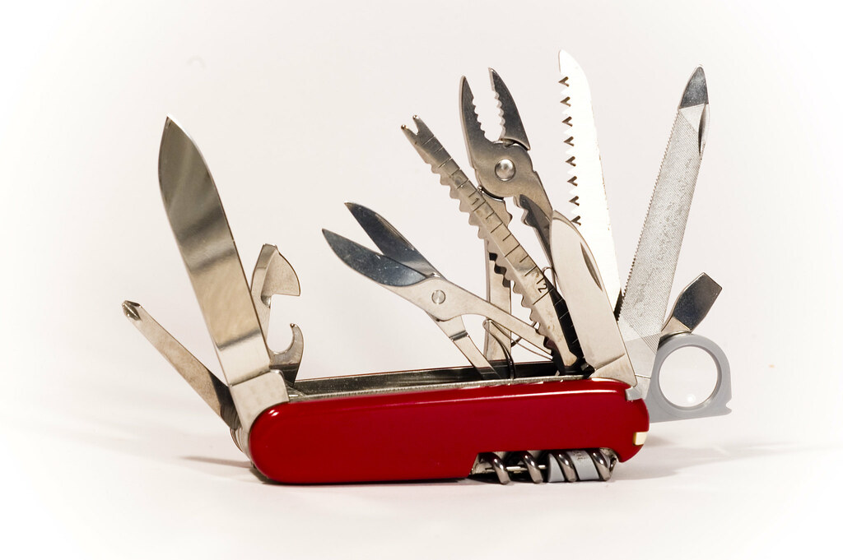
Commands
cy
.visit(url: string)
Can only be run at the beginning
Domain can't be changed
.get(selector)
Uses jQuery selectors
.contains
.click
.type

Slide 18
An E2E Test in Cypress
it('should rename Latitia to Laetitia', () => {
cy.visit('');
cy.get('mat-drawer a').contains('Customers').click();
cy.get('div').contains('Latitia Bellitissa').siblings('.edit').click();
cy.get('input:first').clear().type('Laetitia');
cy.get('button[type=submit]').click();
cy.get('div').contains('Bellitissa').should('have.text', 'Laetitia Bellitissa');
});

Slide 19
Assertions Implicit
Behaves like a normal command
Does waiting as well
Good for single assertions
cy
.get('h1')
.should(
'have.text',
' Unforgettable Holidays '
);

Slide 20
Assertions Explicit
More verbose
Good for multiple assertions
Massaging
cy.get('h1').should(($h1) => {
expect($h1).to.have
.text(' Unforgettable Holidays ');
});

Slide 21
Cypress Goodies
lodash: Cypress._
jQuery: Cypress.$
Moment: Cypress.moment
Uses Mocha and Chai
Not Jest
Very similar commands
Notes:
Moment will be removed

Slide 22
When not to use Cypress?
Cross Browser Support
Multiple Super Domains
Notes:
Moment will be removed

Slide 23
Demo
Notes:
Run Cypress/init
Explain tsconfig.json
Explain the provided integration tests
Select Holiday, select button

Slide 24
Flakiness / Unreliability
describe('Customers', () => {
it('should add a customer', () => {
cy.visit('');
cy.get('a').contains('Customers').click();
cy.get('a').contains('Add Customer').click();
});
});

Slide 25
Flakiness / Unreliability
Commands are not retried when they are successful
Chains are multiple commands
cy.get & cy.contains are commands
cy.get('a').contains('Add Customer').click();
1
2

Slide 26
Prevent Flakiness by Assertion
describe('Customers', () => {
it('add customer', () => {
cy.visit('');
cy.get('a').contains('Customers').click();
cy.get('a').should('contain', 'Add Customer');
cy.get('a').contains('Add Customer').click();
});
});

Slide 27
Prevent Flakiness by a better Selection
describe('Customers', () => {
it('add customer', () => {
cy.visit('');
cy.get('mat-drawer a').contains('Customers').click();
cy.get('mat-drawer-content a').contains('Add Customer').click();
});
});

Slide 28
Prevent Flakiness by a much better Selection
describe('Customers', () => {
it('add customer', () => {
cy.visit('');
cy.get('[data-test=btn-customers]').click();
cy.get('[data-test=btn-add-customer]').click();
});
});

Slide 29

Lab Time

